Slide 1



REAL-TIME EMOTION DETECTION WITH KAFKA AND MACHINE LEARNING
Ann Maria John, Divya Neelamegam,
Kartik Mukkavilli, Poojitha Venkat Ram, Shruti Badrinarayanan
GROUP 8

Slide 2
01.
INTRODUCTION
02.
LITERATURE SURVEY
03.
METHODOLOGY
04.
EXPLORATORY DATA ANALYSIS
05.
DATA PREPROCESSING
06.
MODELING AND EVALUATION
07.
GUI APPLICATION
AGENDA
08.
CONCLUSION AND FUTURE WORK

Slide 3
PROBLEM STATEMENT
Real-Time Emotion Analysis: Addressing the need for instant comprehension and response to human emotions.
Data Challenges: Tackling issues in gathering, analyzing, and deciphering large volumes of emotional data from sources like social media, consumer contacts, and live events.
Machine Learning Integration: Combining robust machine learning models with Kafka for efficient and real-time emotional analysis.
Key System Challenges: Overcoming obstacles related to data ingestion, processing speed, model accuracy, and scalability to deliver immediate insights and effective responses to human emotions.

Slide 4

01.
INTRODUCTION

Slide 5
INTRODUCTION
Objective: Develop a system for real-time emotional context recognition using classification algorithms.
Robust Dataset: Kaggle-sourced Twitter dataset with six primary emotions.
Real-Time Emotion Detection: Imperative for customer experiences, sentiment analysis, and personalized services.
Integrated System: Harnessing Apache Kafka, Spark Streaming, and ML for immediate emotion recognition.
Applications: Extends to sentiment analysis, customer feedback analysis, personalized marketing, and adaptive user interfaces across diverse domains.

Slide 6
DATA SOURCE
Source
Dataset acquired from Kaggle : https://www.kaggle.com/datasets/parulpandey/emotion-dataset
Content
English Twitter messages for emotion analysis. (20000 records in total)
Emotions
Six basic emotions targeted: Anger, Fear, Joy, Love, Sadness, Surprise.
Structure
Data attributes: “text” (Tweet) and “label” (Emotion).
Pre-split into training, validation, and test sets.
Collection Method
Tweets compiled using Twitter API based on emotion-specific hashtags.
Usage
Directly utilized for preprocessing without modification.

Slide 7
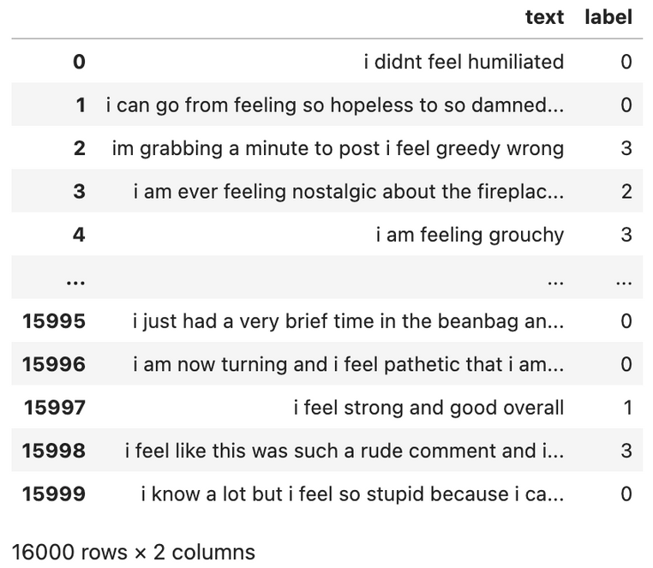
DATA SOURCE
Raw Data (Training Set)

Slide 8
02.
LITERATURE
SURVEY

Slide 9
LITERATURE SURVEY
Study Details | Dataset Used | Algorithms/Methods Used
Pang, B., & Lee, L. (2008). Opinion mining and sentiment analysis. Foundations and Trends® in Information Retrieval, 2(1–2), 1–135 | Kaggle | Opinion mining, Sentiment Analysis
Zaharia, M., et al. (2012). Discretized Streams: An Efficient and Fault-Tolerant Model for Stream Processing on Large Clusters. In USENIX Annual Technical Conference. | Kaggle | Discretized Streams
Kreps, J., et al. (2011). Kafka: A Distributed Messaging System for Log Processing. In NetDB, USENIX. | Twitter data | Kafka
Mohammad, S. M., et al. (2018). SemEval-2018 Task 1: Affect in Tweets. In Proceedings of the 12th International Workshop on Semantic Evaluation (SemEval-2018), 1-17. | SemEval-2018 Task 1 Affect in Tweets Dataset | Twitter Analysis
Bollen, J., et al. (2011). Twitter's mood predicts the stock market. Journal of Computational Science, 2(1), 1-8. | Twitter data | Mood prediction
Liu, B. (2015). Sentiment Analysis: Mining Opinions, Sentiments, and Emotions. Cambridge University Press. | Kaggle | Sentiment Analysis

Slide 10
03.
METHODOLOGY

Slide 11
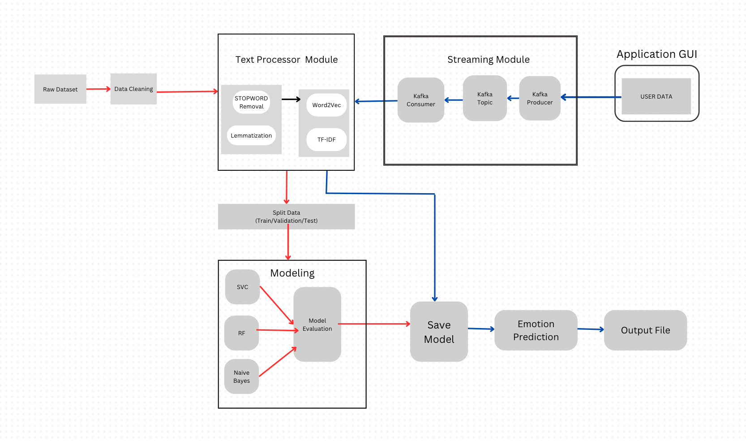
METHODOLOGY

Slide 12
04.
EXPLORATORY DATA ANALYSIS

Slide 13
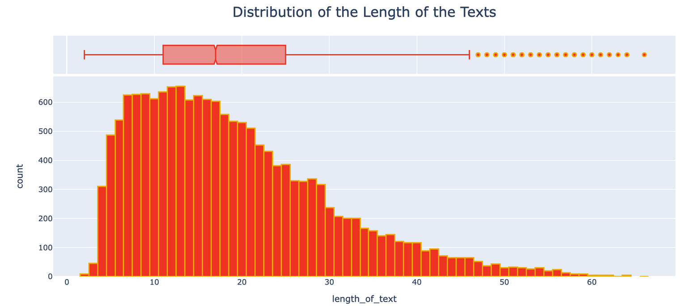

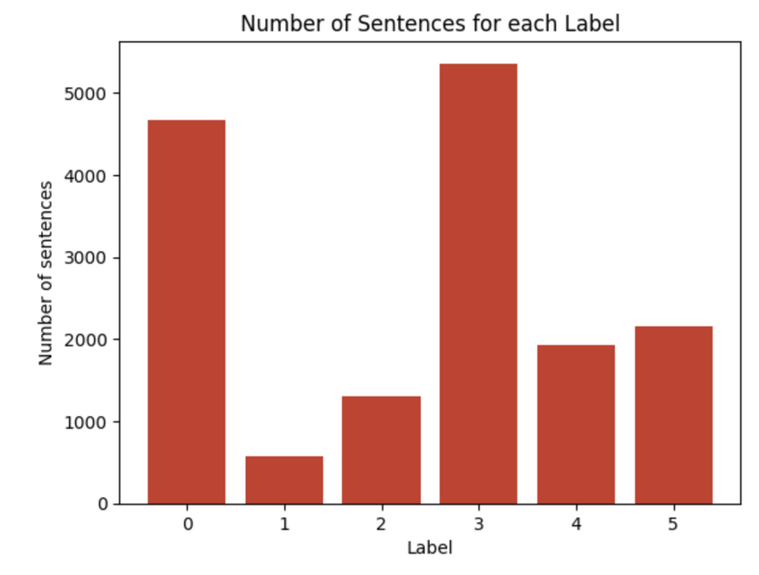
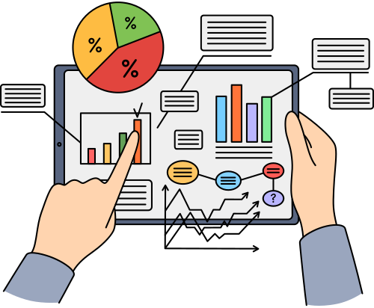


Slide 14
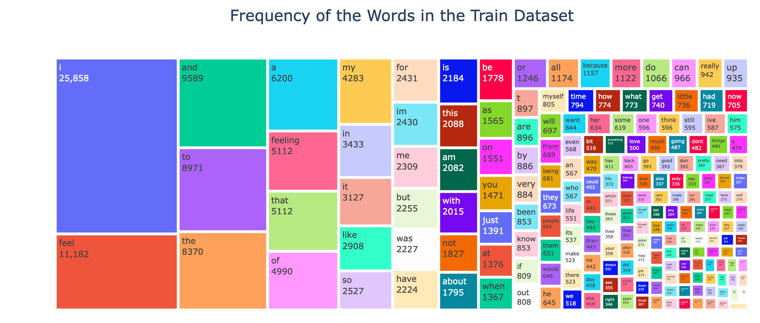

Slide 15
05.
DATA PREPROCESSING

Slide 16
DATA PREPROCESSING
Objective: Prepare text data for ML model training.
Steps
Lowercasing: Convert all text to lowercase for consistency.
Tokenization: Split text into words for processing.
Negation Handling: Prefix words after "not" with "not_".
Lemmatization: Reduce words to base form.
Stop Word Removal: Exclude common words with little meaning.
Clean Non-Alphanumeric: Remove punctuation and numbers.
TF-IDF Vectorization: Transform text to numerical values reflecting word importance.
Application
Apply preprocessing.
Save vectorized data in space-efficient .npz format.
Outcome
Enhanced model quality and performance.
Processed data located in 'Preprocessed Data' directory.

Slide 17
06.
MODELLING AND EVALUATION

Slide 18
MODELING
Models Developed - Naive Bayes, SVC, Random Forest
Steps -
Initialize the model
Fit the model
Make predictions on the validation set
Evaluate validation set performance - accuracy, precision, recall, F1 score
Define hyperparameter grid
Use GridSearchCV to find the optimal hyperparameters
Train the classifier again with the best hyperparameters
Make predictions on validation and test sets
Evaluate validation and test set performance - accuracy, precision,
recall, F1 score, confusion matrix

Slide 19
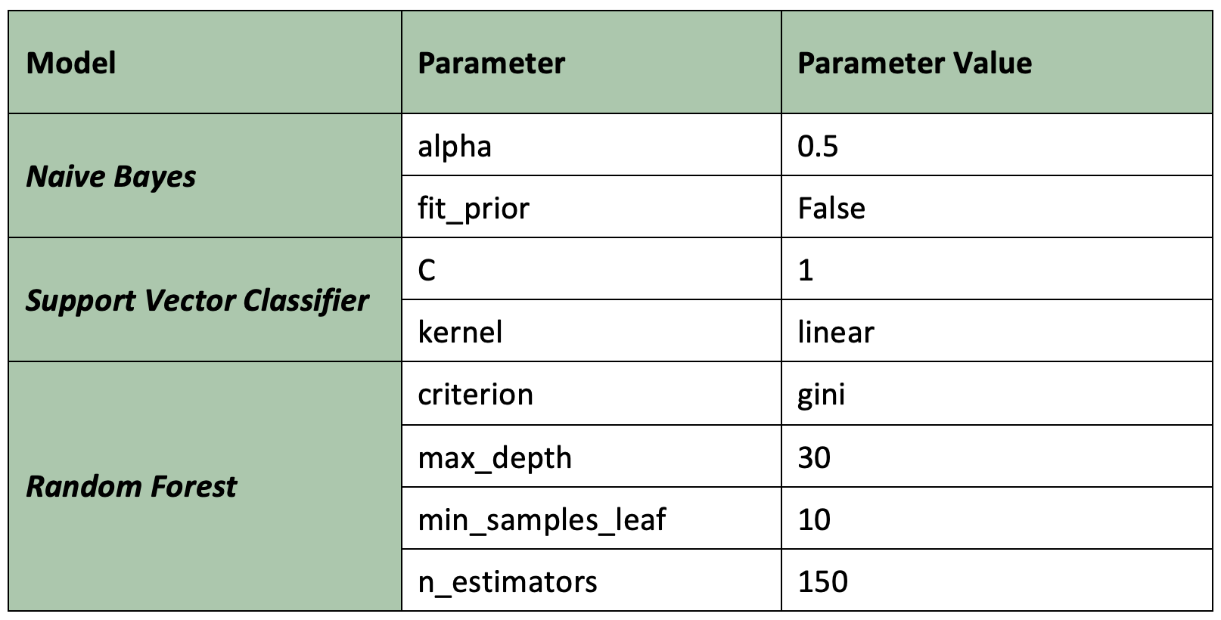
OPTIMAL HYPERPARAMETER CONFIGURATION

Slide 20
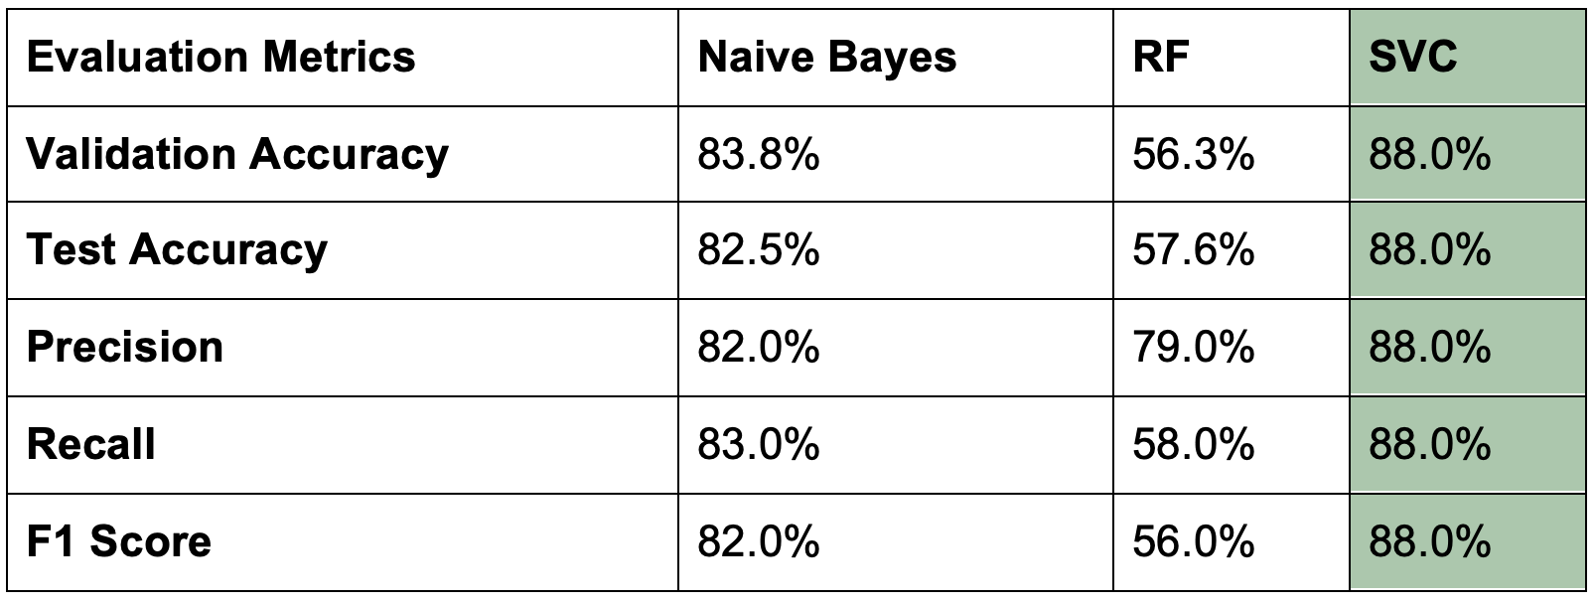
MODEL PERFORMANCE EVALUATION

Slide 21
07.
EMOTION DETECTION GUI APPLICATION

Slide 22
APACHE KAFKA : TOPIC CREATION
A dedicated Kafka topic, named "emotion-detection-stream," has been created to serve as the communication channel for these messages.
The Kafka topic is configured with a replication factor of 1 and a single partition, ensuring simplicity and ease of management.
ESTABLISHING 'EMOTION-DETECTION-STREAM' KAFKA TOPIC FOR MESSAGE COMMUNICATION :
OVERVIEW OF KAFKA TOPICS ON THE SERVER:

Slide 23
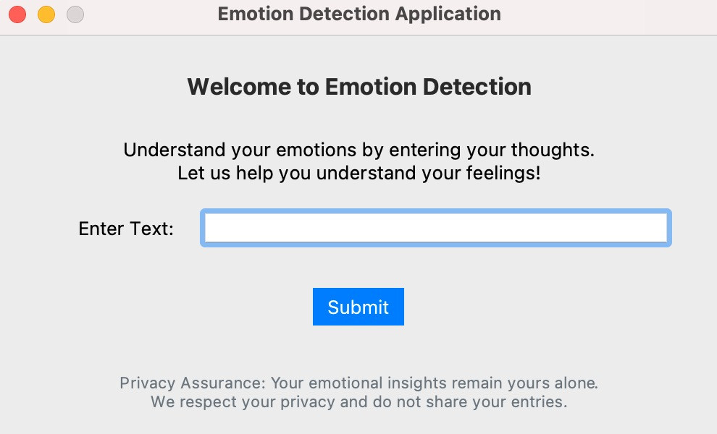
GUI - PRODUCER
APPLICATION WINDOW
Development
Built with PyQt and Python for a dynamic UI experience.
Functionality
Users input text for real-time emotion analysis (which is saved).
Subsequently, saved data is processed and cleaned, and machine learning is used to predict the emotion label.

Slide 24
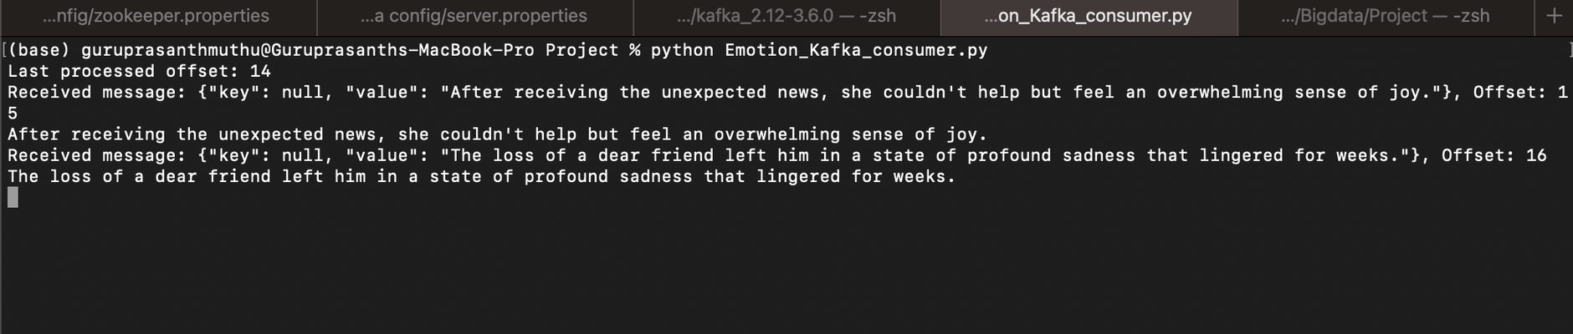
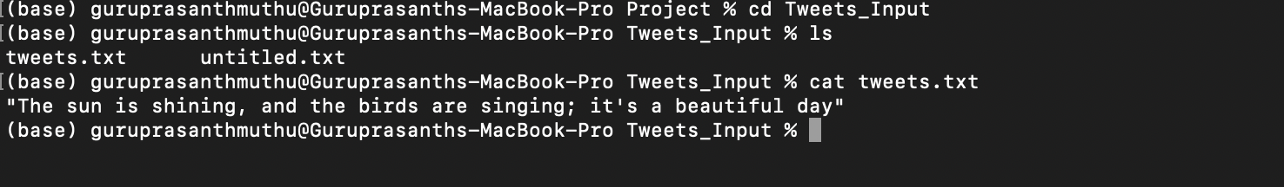
KAFKA CONSUMER
KAFKA CONSUMER IS DEPLOYED TO CONTINUOUSLY LISTEN TO THE "EMOTION-DETECTION-STREAM" AND STORED IN A FILE “TWEET.TXT” FOR FURTHER PROCESSING.
The consumer is configured with certain parameters, such as "auto_offset_reset" set to 'earliest' to read messages from the beginning, "enable_auto_commit" set to False to disable automatic offset commits,
"group_id" set to None, indicating the absence of a consumer group, thereby ensuring a clean and straightforward data retrieval process.
the management of Kafka offsets to prevent data loss in the event of Kafka restart is addressed by storing the offset information in an external file named 'external_offset.txt.'
REAL-TIME DATA CONSUMPTION BY KAFKA CONSUMER:

Slide 25
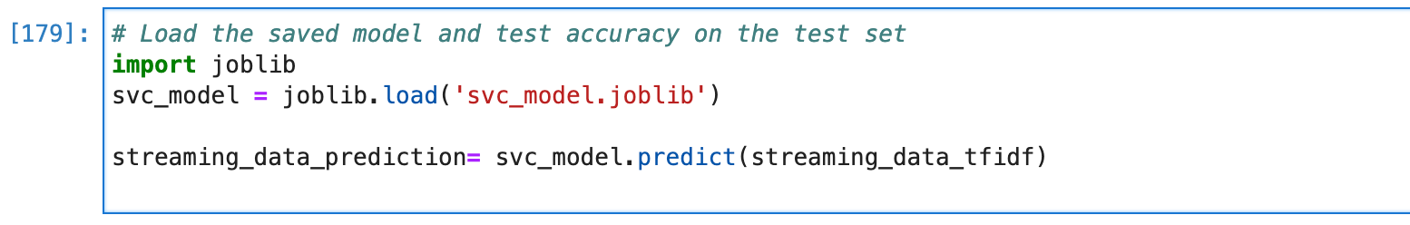
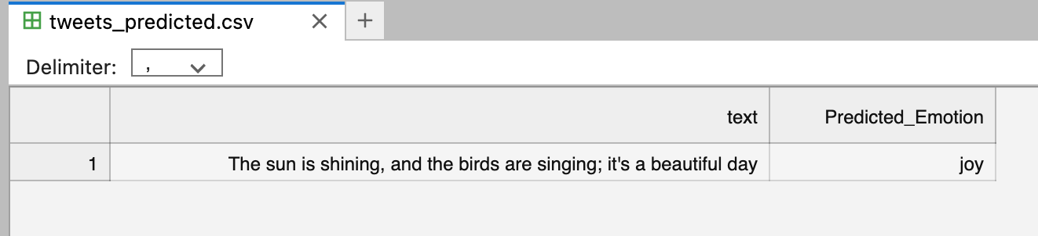
EMOTION PREDICTION USING SVC
THE STREAMING DATA INGESTION AND PROCESSING PIPELINE KICKSTARTS WITH THE CONSUMPTION OF THE 'TWEET.TXT' FILE, HOUSING A CONTINUOUS STREAM OF USER-GENERATED TEXT DATA.
The preprocessing steps encompass essential tasks such as stopword removal, lemmatization, and vectorization using both Word2Vec and TF-IDF processes.
Pre-trained SVC Model is invoked to predict the emotion classification of the Real-Time tweets stored in ‘tweet.txt’ file
FINAL OUTPUT

Slide 26
08.
CONCLUSION AND FUTURE WORK

Slide 27
CONCLUSION
Top-Performing Model: Among Naive Bayes, SVC, and Random Forest, SVC stands out with superior accuracy, precision, and recall.
SVC Dominance: The highest metrics confirm SVC as the superior model for emotion interpretation.
Real-Time Success: ML, Spark Streaming, and Kafka integrate seamlessly for live emotion detection, offering profound insights from textual data.
Versatile Applications: Sentiment analysis, feedback, and adaptive interfaces.

Slide 28
FUTURE WORK
Multilingual emotion recognition: Capturing linguistic nuances using
methods such as language-specific fine-tuning or multilingual embeddings.
Twitter Streaming API: Using the Twitter Streaming API to predict emotion on streaming tweets based on keywords, hashtags, or user accounts focusing on a particular area of study.
Employing deep learning techniques: Capturing rich contextual information in textual emotional expressions using BERT and other pre-trained models.

Slide 29
REFERENCES
Pang, B., & Lee, L. (2008). Opinion mining and sentiment analysis. Foundations and Trends® in Information Retrieval, 2(1–2), 1–135.
Zaharia, M., et al. (2012). Discretized Streams: An Efficient and Fault-Tolerant Model for Stream Processing on Large Clusters. In USENIX Annual Technical Conference.
Kreps, J., et al. (2011). Kafka: A Distributed Messaging System for Log Processing. In NetDB, USENIX.
Mohammad, S. M., et al. (2018). SemEval-2018 Task 1: Affect in Tweets. In Proceedings of the 12th International Workshop on Semantic Evaluation (SemEval-2018), 1-17.
Bollen, J., et al. (2011). Twitter's mood predicts the stock market. Journal of Computational Science, 2(1), 1-8.
Liu, B. (2015). Sentiment Analysis: Mining Opinions, Sentiments, and Emotions. Cambridge University Press.
Carbone, P., et al. (2015). Apache Flink: Stream and Batch Processing in a Single Engine. IEEE Data Engineering Bulletin, 38(4), 28-38.

Slide 30
THANK YOU
Have any questions?

